Slide 1
ACE Self-study
haixiang.liu@emerson.com

Slide 2
Event (computing)
https://en.wikipedia.org/wiki/Event_(computing)
In computing, an event is an action or occurrence recognized by software that may be handled by the software.
Typically, events are handled synchronously with the program flow, that is, the software may have one or more dedicated places where events are handled, frequently an event loop.
In computer programming, an event handler is a callback subroutine that handles inputs received in a program (called a listener in Java and JavaScript^{[2]}).
Created events are first processed by an event dispatcher within the framework. It typically manages the associations between events and event handlers, and may queue event handlers or events for later processing. Event dispatchers may call event handlers directly, or wait for events to be dequeued with information about the handler to be executed.

Slide 3
Event (computing)
Event dispatcher (Event loop)
event handler 1
(listener)
event 1
event 3
event 2
event 1
event 1
event handler 2
Event queue
(message queue)
event 2
event handler 3
event 3
event handler 4

Slide 4
Basics
Blocking I/O (synchronous I/O)
start the I/O access and then wait for it to complete
block the progress of a program while the communication is in progress, leaving system resources idle
When a program makes many I/O operations (such as a program mainly or largely dependent on user input), this means that the processor can spend almost all of its time idle waiting for I/O operations to complete.
non blocking I/O (asynchronous I/O)
start the communication and then perform processing that does not require that the I/O be completed
Any task that depends on the I/O having completed (this includes both using the input values and critical operations that claim to assure that a write operation has been completed) still needs to wait for the I/O operation to complete, and thus is still blocked
but other processing that does not have a dependency on the I/O operation can continue.

Slide 5
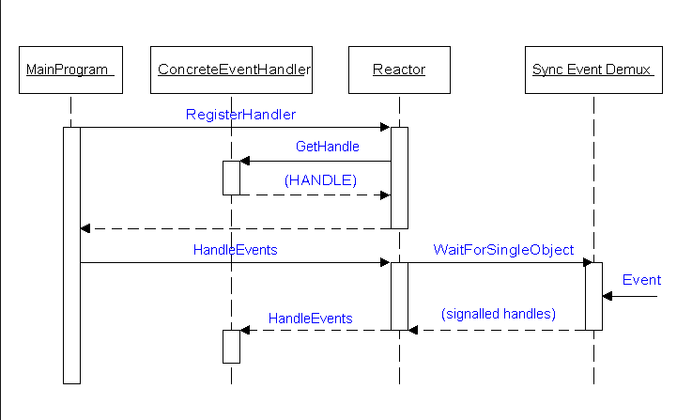
Design pattern
Reactor
Facilities a reactive I/O model, with events signaling the ability to begin a synchronous I/O operation
The reactor design pattern is an event handling pattern for handling service requests delivered concurrently to a service handler by one or more inputs.
The service handler then demultiplexes the incoming requests and dispatches them synchronously to the associated request handlers.^{[1]}

Slide 6
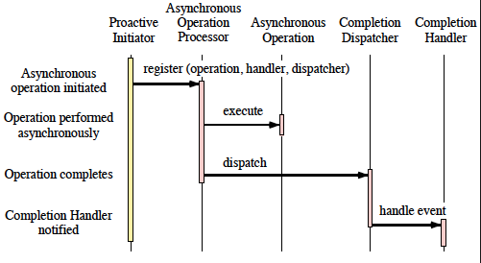
Design pattern (cont.)
Proactor
Proactor is a software design pattern for event handling in which long running activities are running in an asynchronous part. A completion handler is called after the asynchronous part has terminated.
Proactive I/O model where one or more asynchronous I/O operations are initiated and the completion of each operation triggers an event
In contrast to the reactor pattern, the proactor pattern has operations start regardless of whether they can finish immediately or not, has them performed asynchronously, and then arranges to deliver notification about their completion.

Slide 7
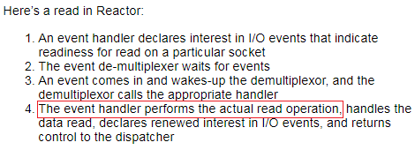
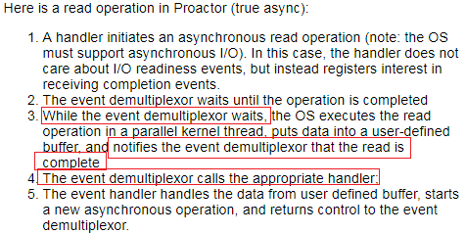
Design pattern (cont.)
Reactor vs Proactor
Reactor pattern is about asynchronous (so non-blocking) calls, but synchronous (blocking) processing of those calls (event handler)
Proactor is about asynchronous (non-blocking) calls and asynchronous (non-blocking) processing of those calls. Event handler only called when completion (which is asynchronous).

Slide 8
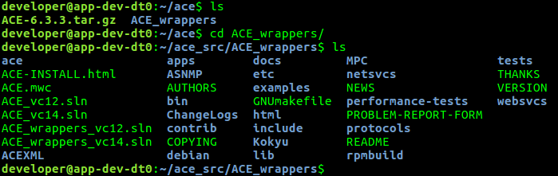
Install ACE libraries
Source code
https://github.com/DOCGroup/ACE_TAO/releases
Documentation
http://www.dre.vanderbilt.edu/Doxygen/6.3.3/html/
Installation
http://www.dre.vanderbilt.edu/~schmidt/DOC_ROOT/ACE/ACE-INSTALL.html#unix

Slide 9



Install ACE libraries (cont.)
Set environment
Create a configuration file
Create a build configuration file

Slide 10
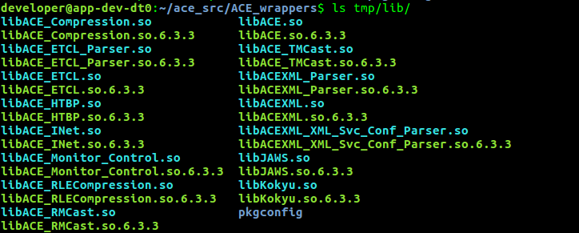

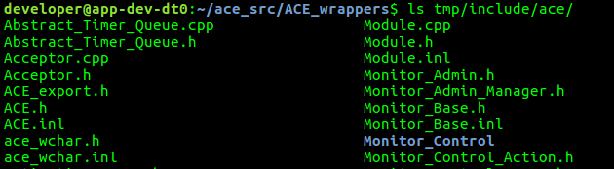
Install ACE libraries (cont.)
Make
source setenv.sh
make
(build will start …)
make install

Slide 11
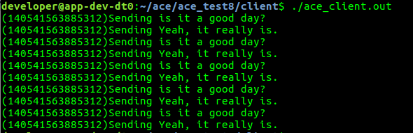
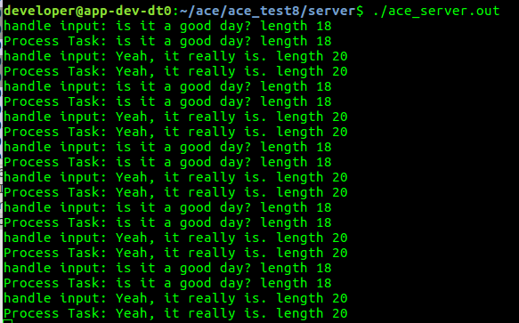
Sample application
https://github.com/haixiang1977/ace/tree/master/ace_test8

Slide 12
Wireshark
Install
sudo apt-get install wireshark
sudo dpkg-reconfigure wireshark-common
choose answer as "YES“
sudo adduser $USER wireshark
log out/log in

Slide 13
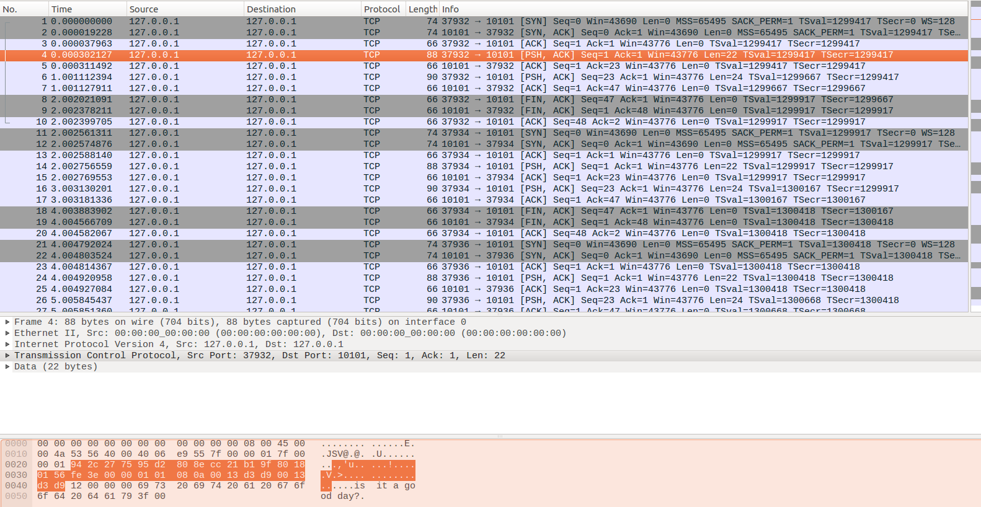
Wireshark (cont.)

Slide 14
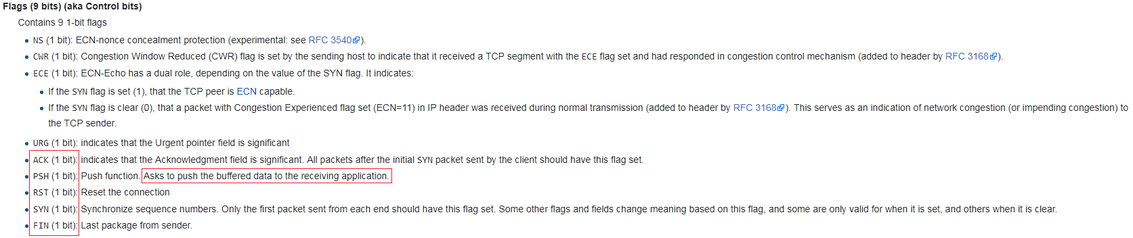
Wireshark (cont.)
TCP/IP
https://en.wikipedia.org/wiki/Transmission_Control_Protocol
Flag

Slide 15
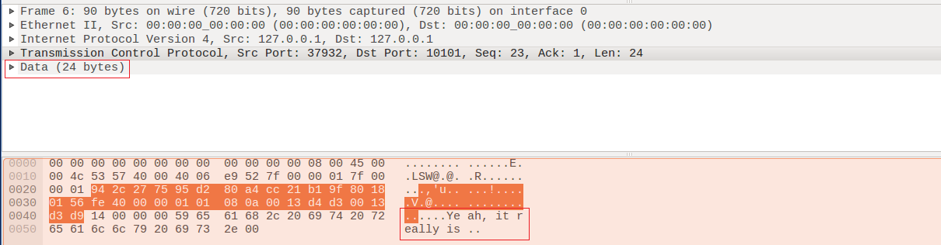
Wireshark (cont.)
SYN
PSH

Slide 16
Wireshark (cont.)
FIN
Last package from sender which means connection will be closed after

